Slide 1

Balancing Act of the
Rapid Rising S&P500
Steven Jedael
Darcel Heckstall
Dimpal Gajjar
Andrew LoPresti

Slide 2


Slide 3
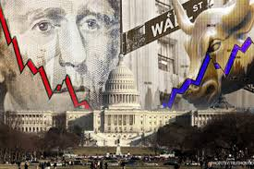

Slide 4
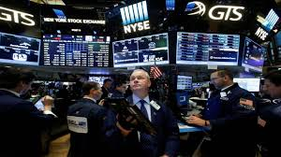

Slide 5

What factors are contributing to the rapid recent rise in the S&P?
Is it performance?
Something else?
We think that examining how companies manage cash flows will be a way to answer this question.
Does Social Media sentiment contribute to short term price increases?

Slide 6
Graph to visualize
Twiiter API
SEC Filling Data
Kaggle Data
D
Compare & Contrast
Earning VS. Average close Comparison
Net cash from Operating activities VS. Average close comparison
Net cash from investing activities VS. Average close comparison
Net cash from financing activities VS. Average close comparison
S&P 500 Companies with Financial Information
The S&P 500 is a free-float, capitalization-weighted index of the top 500 publicly listed stock in the US.
The dataset includes financial statement data of all the stocks in the index.
C
S&P 500 Stock Data
Historical stock data for all current S&P 500 Companies
Provide a dataset with historical stock prices (last 5 years) for all Companies
Twitter pull
Use S&P 500 companies csv file to pull tweets
-Sentiments Analysis for S&P500 Companies
B
A

Slide 7
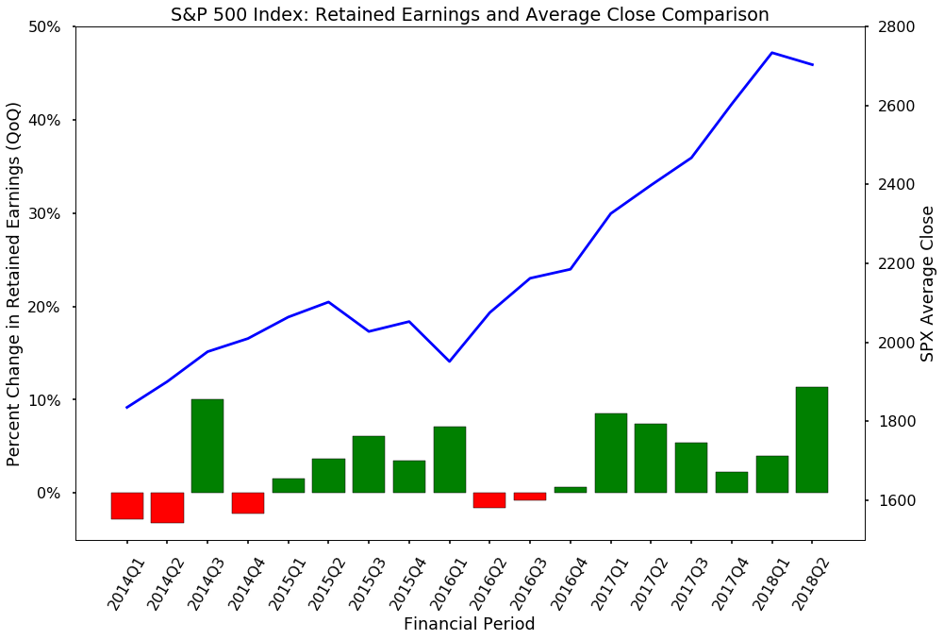

Slide 8
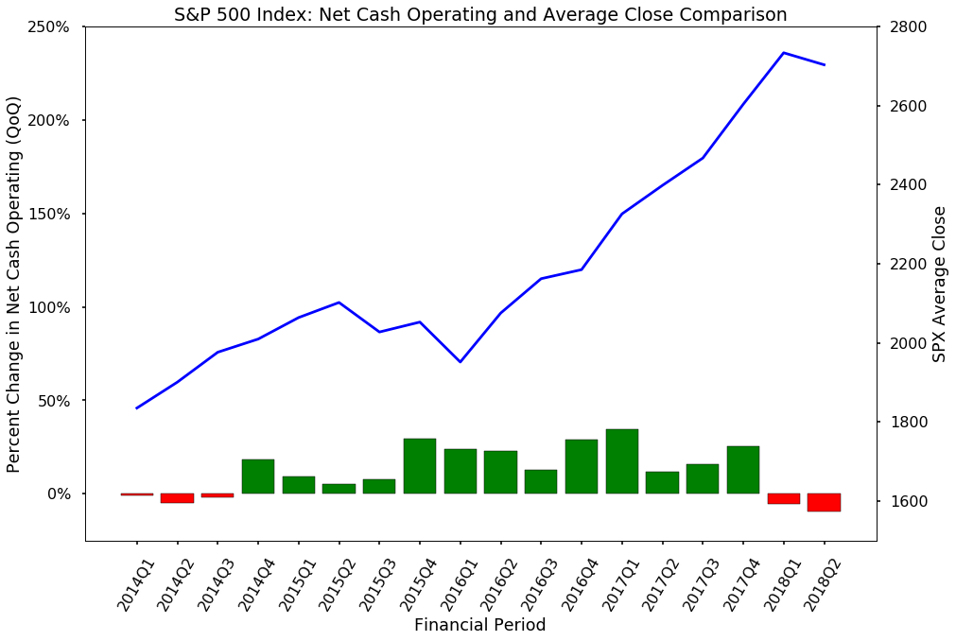

Slide 9
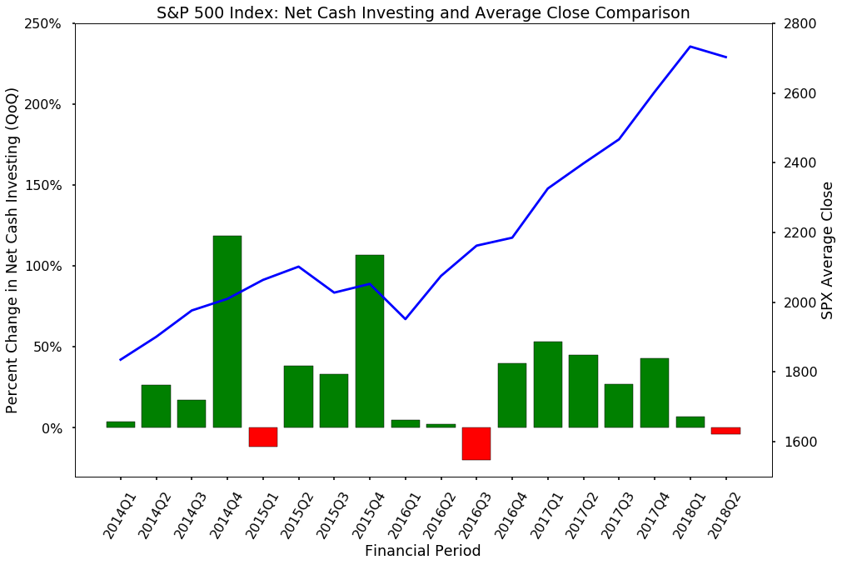

Slide 10
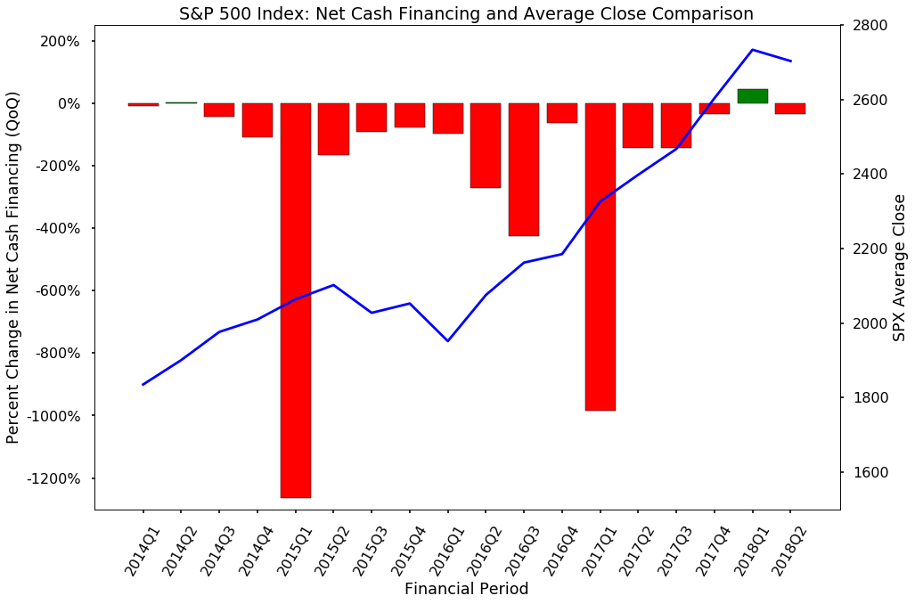

Slide 11

Issues
Fallacy of Causation
Twitter constraints
days
Vader not recognizing financial context/jargon

Slide 12
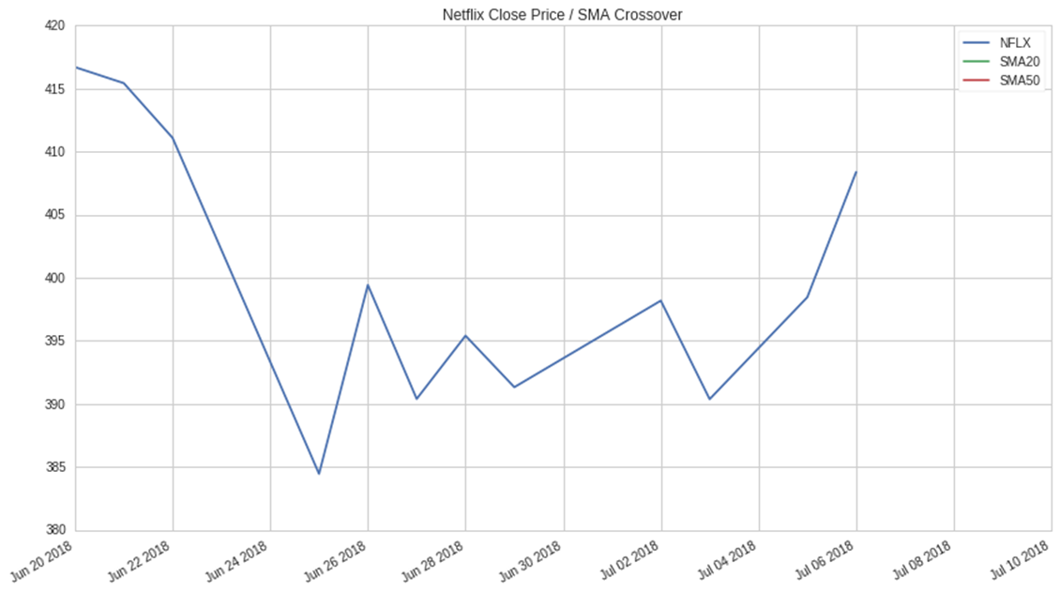

Slide 13
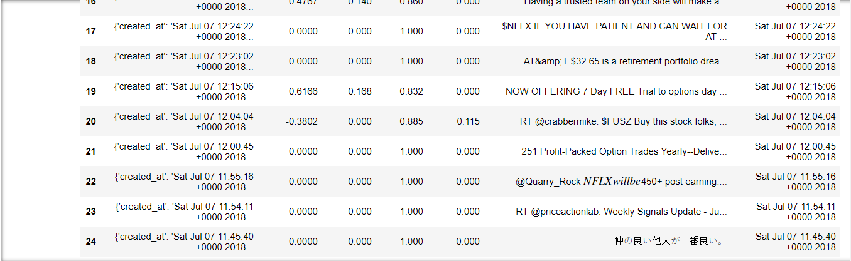
Netflix Sentiments

Slide 14
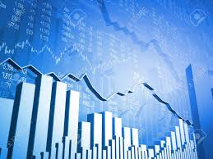
Conclusions…
Efficient management of Debt(solvency)
Sentiment findings
Scan additional sources for sentiment
comparasons(news outlets/presidential tweets/etc..)
Compare sample sets against the broader market
Conclusion

Slide 15


